Slide 1
Python and ACT Tutorials

Slide 2
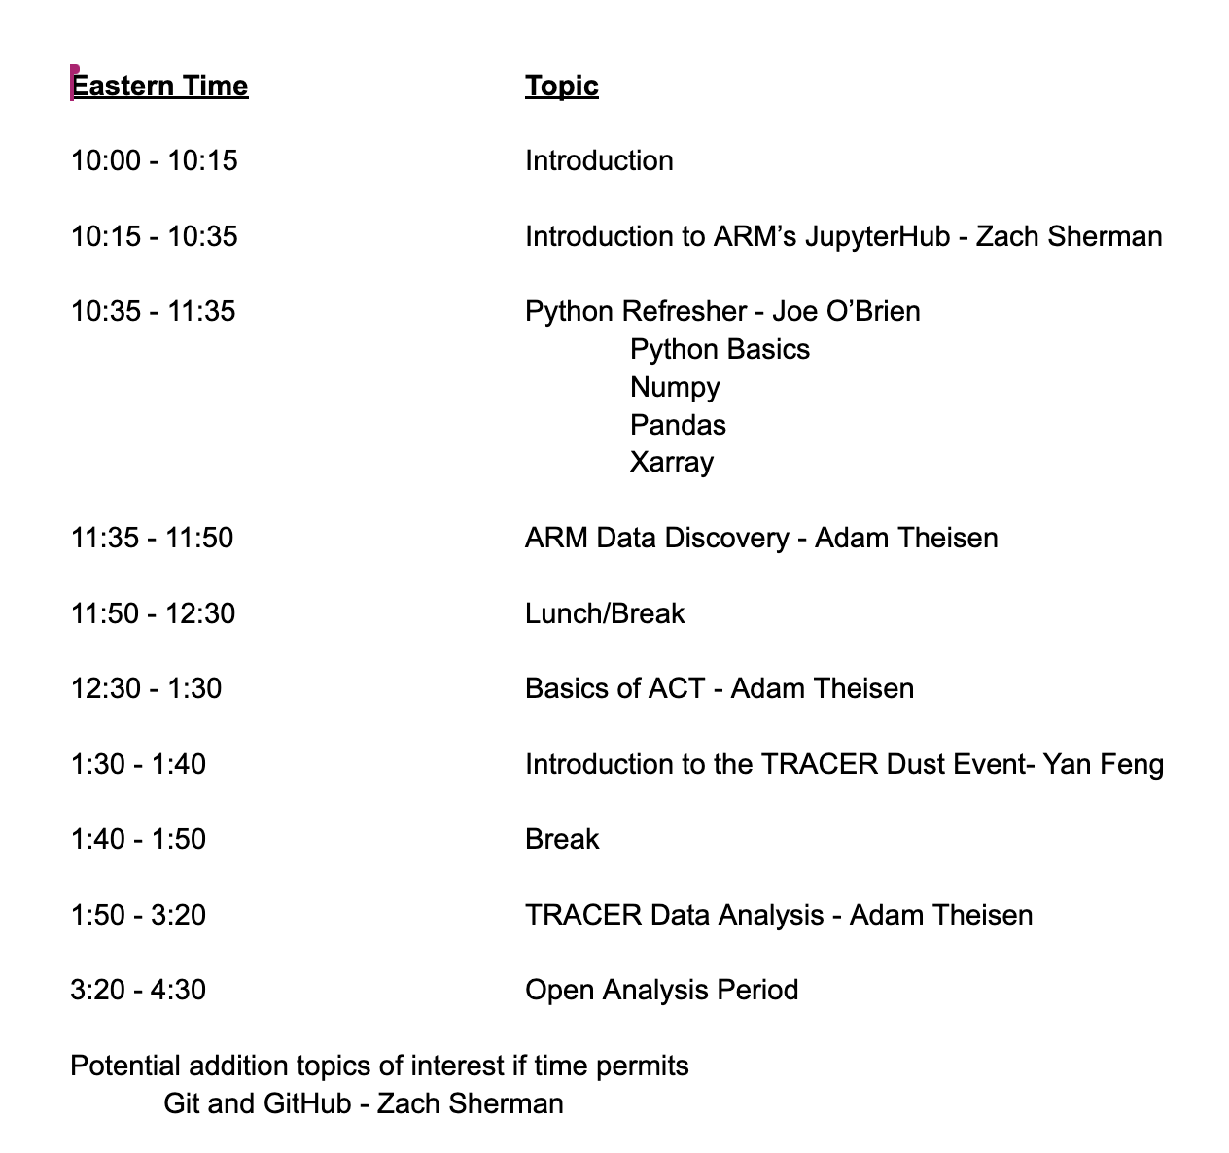
Agenda

Slide 3
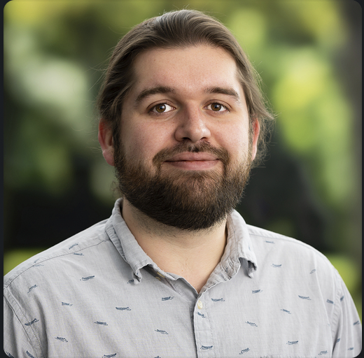
Joe O'Brien
Software Developer
Where you are from
College(s)
Millersville University of PA (BS in Meteorology)
Univ. of North Dakota (MS in Atmospheric Science)
What you are most excited about for the summer (work or non-work)?
Defending my Dissertation / Being done with my PhD

Slide 4
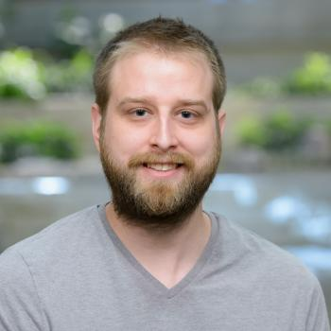
Zach Sherman
Software Developer
Where you are from
College(s)
Lewis University (BS in Environmental Science and Sustainability)
What you are most excited about for the summer (work or non-work)?
Disc golfing, nice weather, and occasional PC gaming

Slide 5
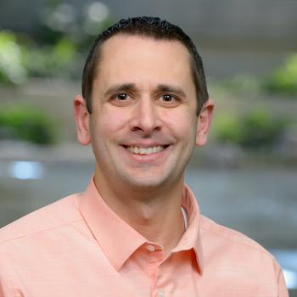
Adam Theisen
ARM Instrument Operations Manager
Where you are from
College(s)
University of North Dakota; BS/MS Atmospheric Science
What you are most excited about for the summer (work or non-work)?
Biking, Kayaking, and Storms

Slide 6
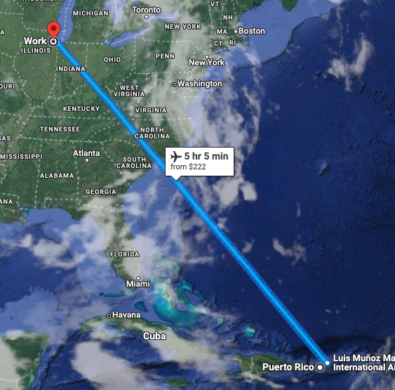
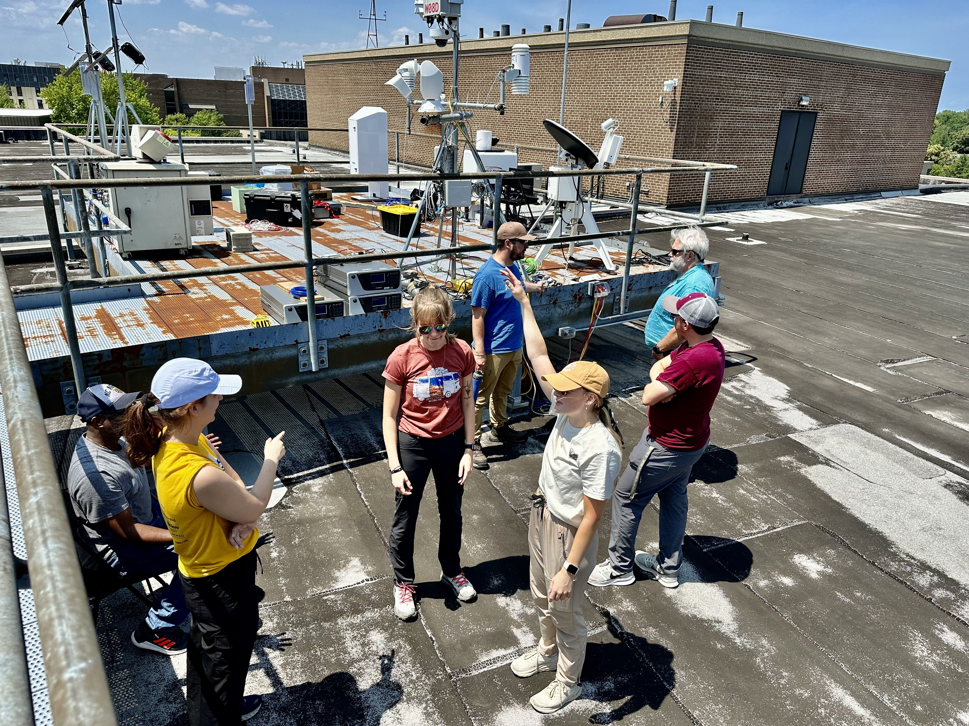
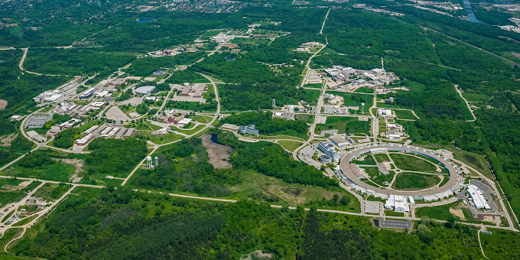




Argonne National Laboratory
Lemont, IL (Suburbs of Chicago)
Science Undergraduate Laboratory Internship (SULI)
Atmospheric Radiation Measurement User Facility (ARM)
Atmospheric Systems Research (ASR) Science Focus Area (SFA)
DOE Urban Integrated Field Laboratory
Community Research on Climate & Urban Science (CROCUS) https://crocus-urban.org/)
Argonne Testbed for Multiscale Observational Science (ATMOS) https://www.anl.gov/evs/atmos/about

